Slide 1
Microsoft Power BI: Overview, Features, and Comparison with Tableau
A study on accessibility, functionality, and integration capabilities
Pedram Sharifani, Ahmad Issa| Data Visualization

Slide 2
Content
Introduction to power bi
Comparison
Demo
Presenting the functionality

Slide 3
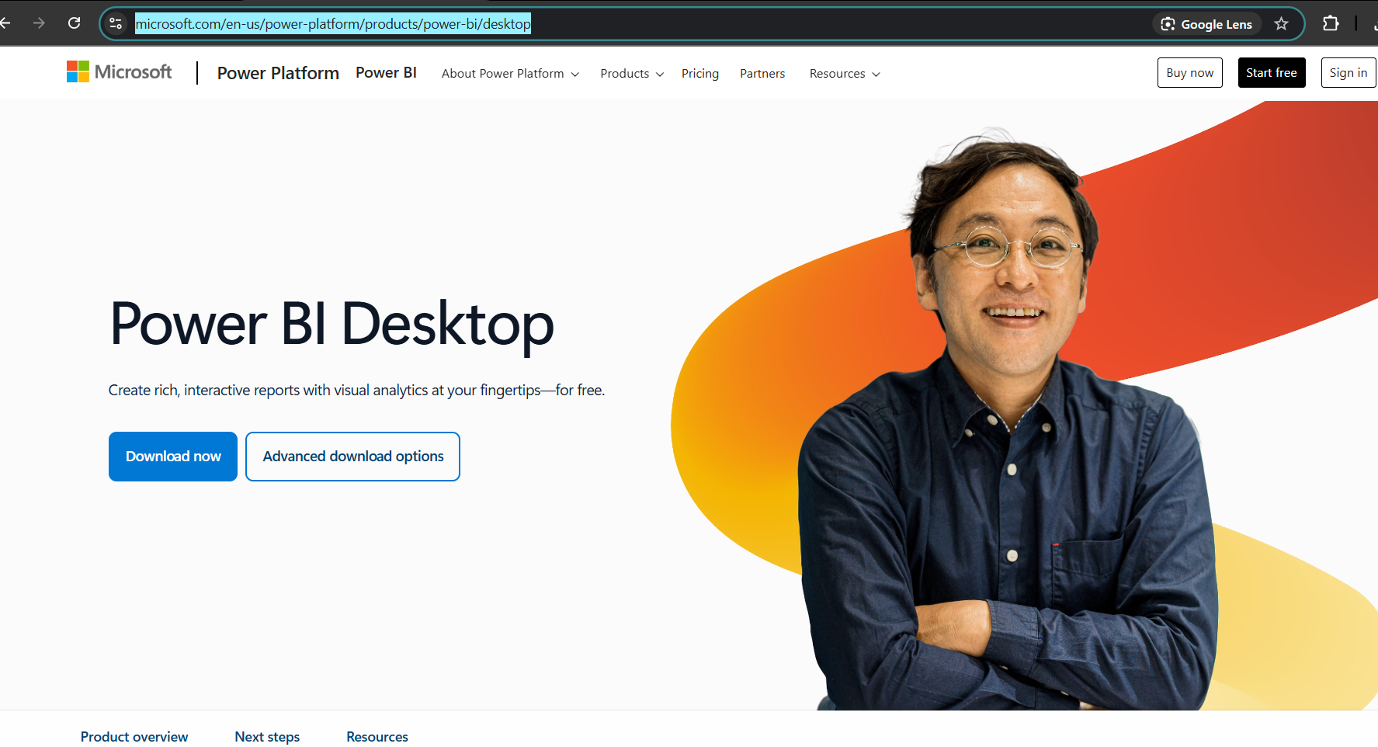
How to get Power BI ?
It is very easy , you can just go to the main Microsoft website and download it
https://www.microsoft.com/en-us/power-platform/products/power-bi/desktop

Slide 4
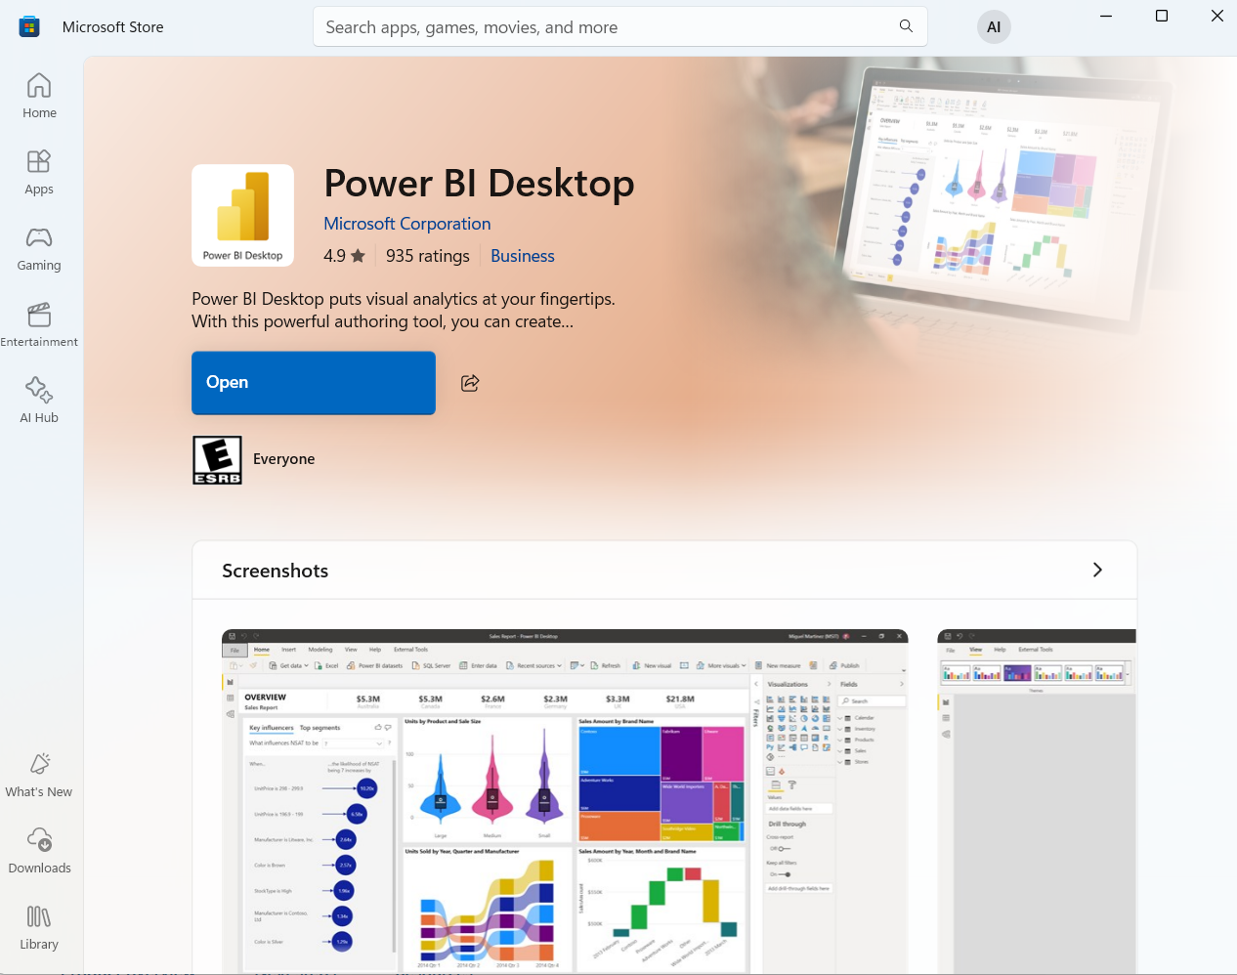
Or if you have a Windows OS you can just download it from your Microsoft Store
https://apps.microsoft.com/store/detail/power-bi-desktop/9NTXR16HNW1T

Slide 5
Introduction to Power BI
Power BI is a business intelligence (BI) and data visualization tool developed by Microsoft.
It helps users analyze, clean, and visualize data efficiently.
A part of the Microsoft Power Platform, integrating well with other Microsoft services.
Used for data-driven decision-making in various industries.

Slide 6
Key Features of Power BI
Interactive Dashboards – Create real-time reports with drag-and-drop functionality.
Data Connectivity – Supports multiple data sources like Excel, SQL Server, and cloud-based services.
Data Transformation – Power Query allows data cleaning and shaping.
AI and Machine Learning – Uses AI-powered insights for predictive analytics.
Collaboration & Sharing – Power BI Service enables cloud-based sharing and collaboration.
Security & Governance – Provides row-level security (RLS) and compliance features.

Slide 7
Power BI Components
Power BI Desktop – For creating reports and dashboards.
Power BI Service – Cloud-based platform for sharing and collaboration.
Power BI Mobile – Access dashboards on smartphones and tablets.
Power Query – Data transformation and cleaning tool.
Power Pivot – Advanced data modeling capabilities.
Power BI Gateway – Connects on-premises data to cloud-based reports.

Slide 8
Power BI vs. Tableau Public – Accessibility
Feature | Power BI | Tableau Public
Ease of Use | User-friendly, integrates with Microsoft tools | Steeper learning curve, more customization options
Data Storage | Local file storage, limited cloud sharing | Must publish publicly on Tableau Public
Collaboration | Limited in free version, requires Power BI Pro for sharing | No private sharing, all work is public
Data Source Connectivity | Supports various local and cloud sources | Limited connections, no direct database access

Slide 9
Power BI vs. Tableau Public – Functionality
Feature | Power BI | Tableau Public
Data Visualization | Provides interactive dashboards with built-in templates and drag-and-drop features. Some advanced visuals (e.g., paginated reports) require a Pro license. | Highly customizable visualizations with a variety of charts, but requires more manual work to format them effectively.
Data Source Connectivity | Supports multiple sources like Excel, CSV, and limited cloud services. Does not allow direct connections to databases unless you upgrade to Power BI Pro. | Only supports Excel, CSV, and Google Sheets. Does not allow connections to databases (SQL Server, MySQL, etc.)—you must import data manually.
Data Refresh | Manual refresh in Power BI Desktop. Automatic refresh requires Power BI Pro. | Data does not refresh automatically—you must manually re-upload files to update dashboards.
AI & Analytics | Provides basic AI-driven insights like Q&A (natural language queries) and Quick Insights. Advanced AI models require Power BI Pro. | No built-in AI analytics or predictive modeling features. Requires manual data manipulation for deeper insights.
Interactivity | Fully interactive reports with filters, slicers, and drill-through capabilities. Users can interact with data locally in Power BI Desktop. | Offers interactive dashboards, but with fewer built-in analytics functions. Requires more effort to create complex interactions.

Slide 10
Power BI vs. Tableau Public – Functionality
Feature | Power BI | Tableau Public
Data Visualization | Built in templates, drag and drop, some visuals needs pro | Customizable visuals, but needs more manual formatting
Data Source Connectivity | Supports many formats; DB access needs Pro | Only supports Excel, CSV, Google Sheets; no DB connections
Data Refresh | Manual by default; auto-refresh needs Pro | No auto-refresh; must re-upload data manually
AI & Analytics | Basic AI tools like Q&A and Insights; advanced needs Pro | No built-in AI; manual data analysis required
Interactivity | Fully interactive with filters, slicers, drill-through | Interactive, but fewer built-in analytics; setup takes more effort

Slide 11
Power BI vs. Tableau Public – Integration
Feature | Power BI | Tableau
Microsoft Integration | Deep integration with Excel, Azure, Teams | Limited Microsoft compatibility
Third-party Support | Supports some external services like Google Analytics, Salesforce, and web APIs, but many third-party connectors require Power BI Pro. | More flexibility with third-party tools, but only supports manual file imports in the free version. No direct API or database connections.
Cloud Services | Native Azure integration, supports OneDrive and limited cloud connectors in the free version. | Works well with AWS and Google Cloud, but data must be imported manually in the free version.
Python Integration | Supports Python scripting for data manipulation, machine learning, and visualizations, but requires enabling Python in settings. Some features may need Power BI Pro. | Supports Python scripting for data cleaning and analytics, but since there’s no live database connection, users must manually refresh and re-upload data after processing.

Slide 12
Power BI vs. Tableau Public – Integration
Feature | Power BI | Tableau
Microsoft Integration | Strong Microsoft ecosystem integration | Limited Microsoft support
Third-party Support | Limited support, many connectors need Pro version | More flexible, but manual imports only in free version
Cloud Services | Azure and OneDrive supported, limited in free tier | AWS and Google Cloud supported, manual imports in free version
Python Integration | Supports scripting, needs setup; some Pro-only tools | Supports scripting, but no live connection; manual data refresh

Slide 13
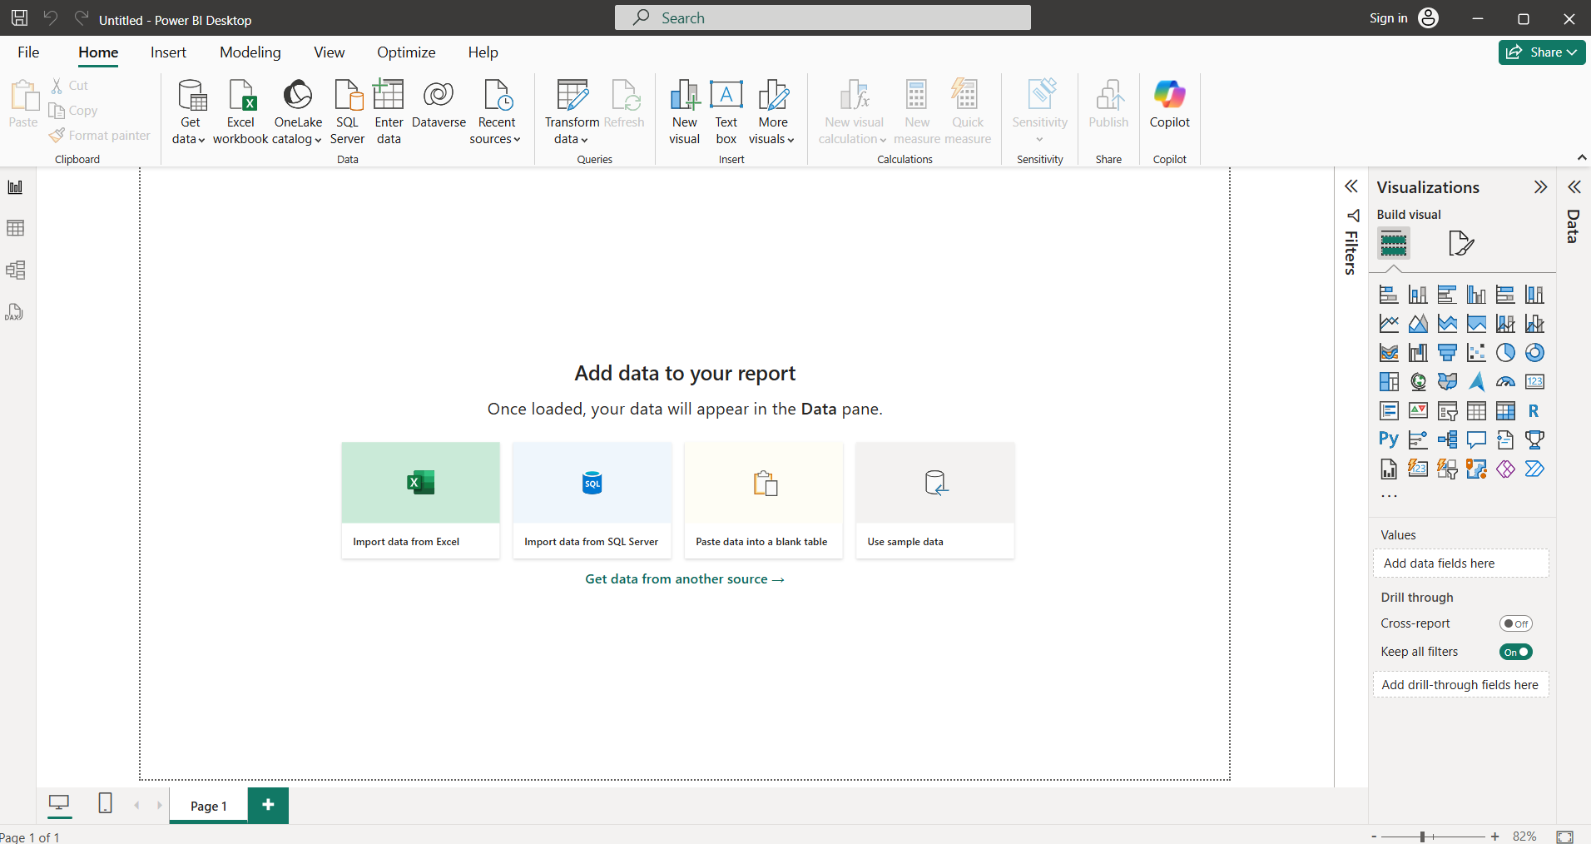

Slide 14
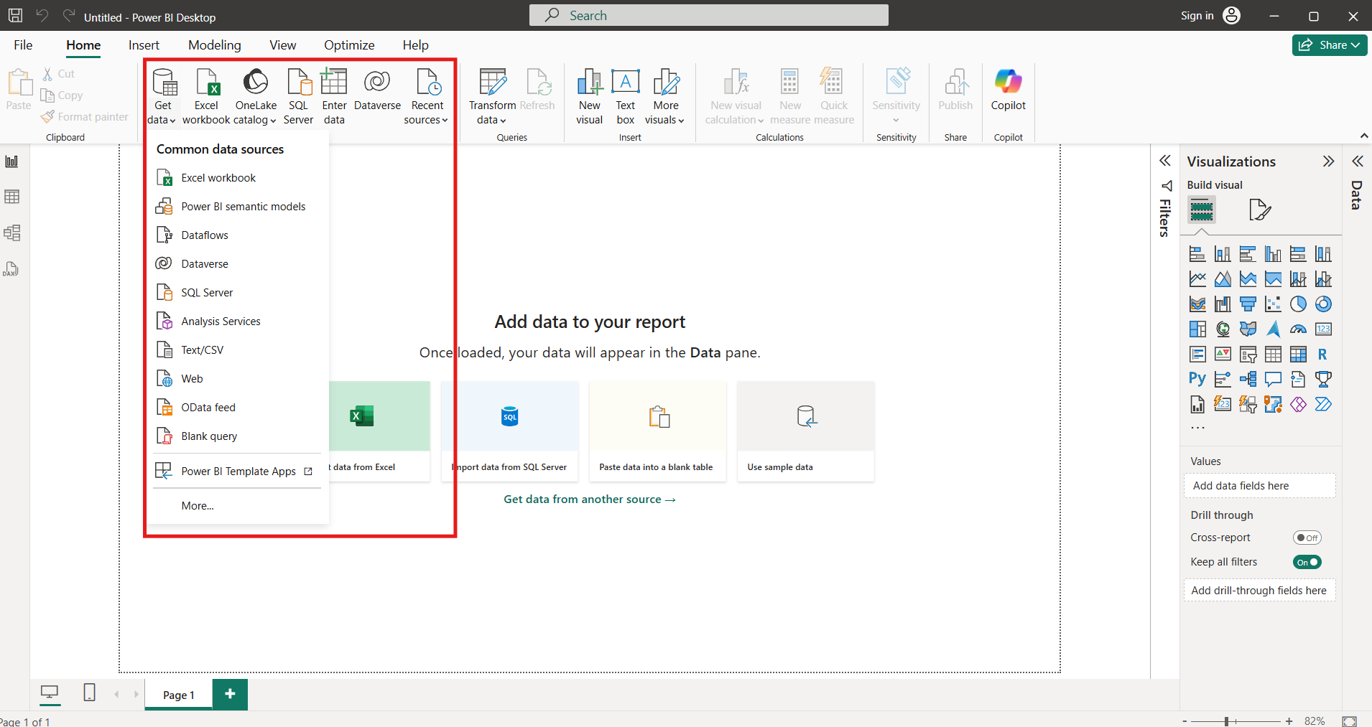

Slide 15
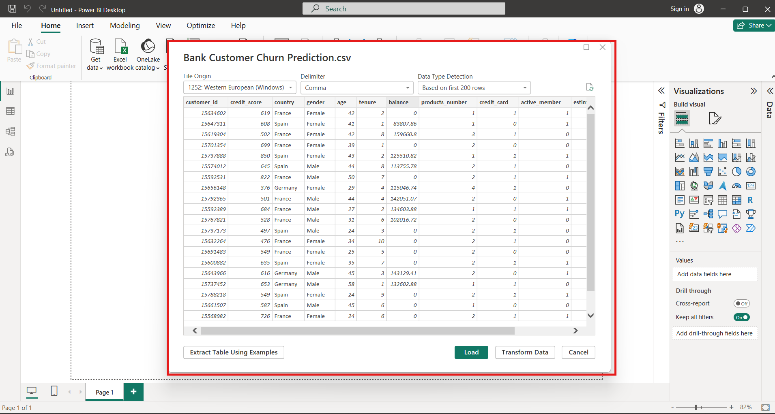

Slide 16
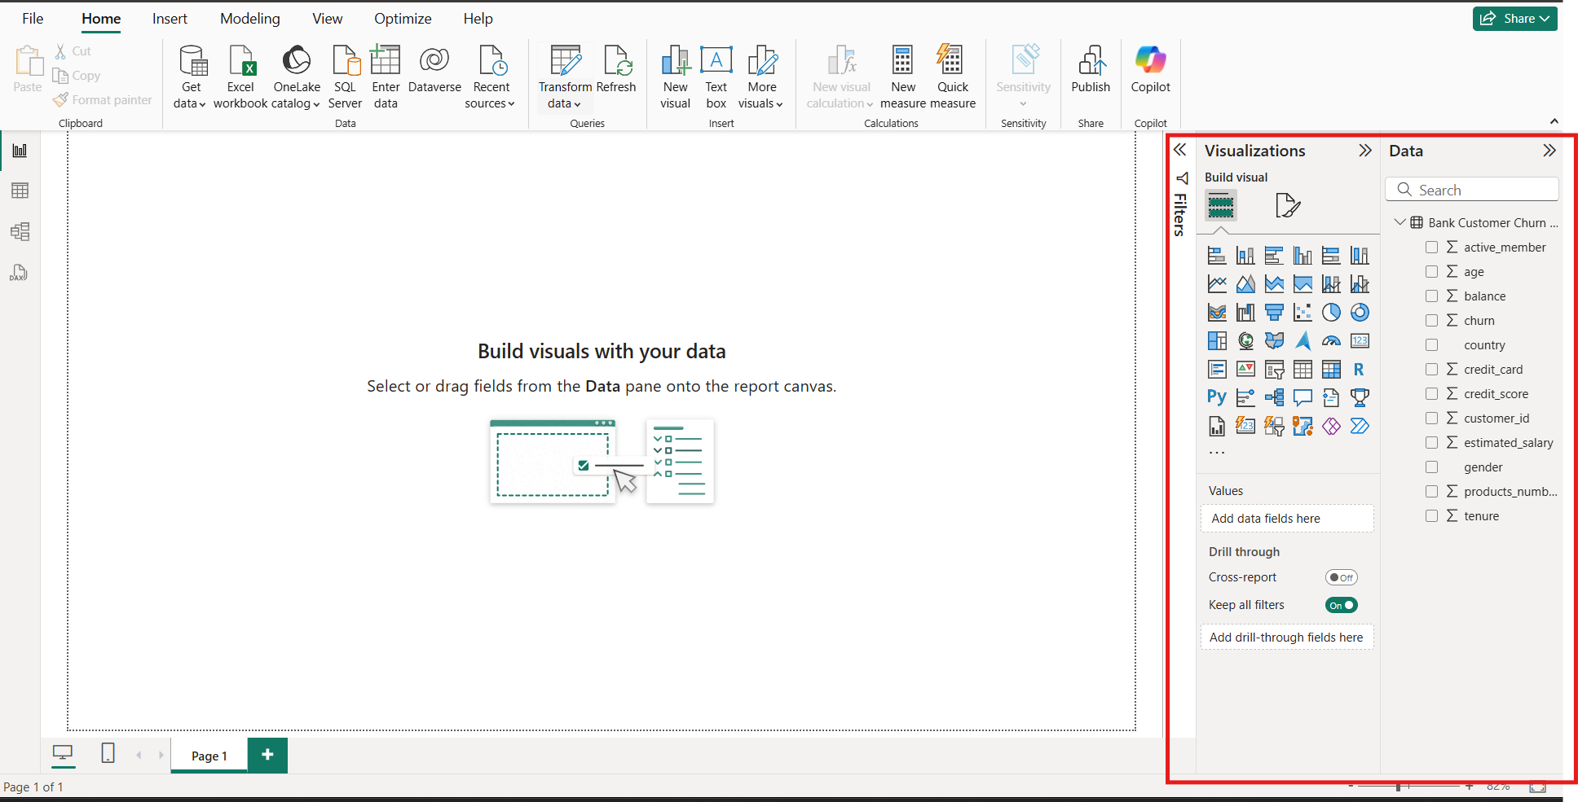

Slide 17
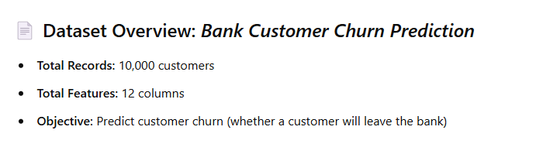
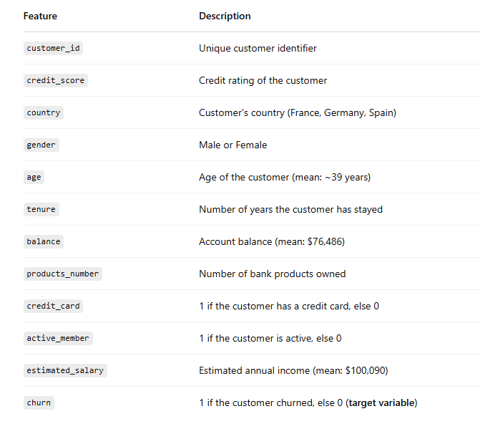

Slide 18
Microsoft Power BI Official Page:https://www.microsoft.com/en-us/power-platform/products/power-bi/desktop
Power BI Overview by Microsoft Learn:https://learn.microsoft.com/en-us/power-bi/fundamentals/power-bi-overview
Power BI vs Tableau Comparison: https://www.g2.com/compare/power-bi-vs-tableau
Tableau Public Features: https://public.tableau.com/en-us/s/
Power BI Components and Architecture: https://radacad.com/power-bi-components-and-their-uses
Power Query and Data Modeling in Power BI https://www.sqlbi.com/guides/power-bi/
Installing Power BI Desktop from Microsoft Store https://apps.microsoft.com/store/detail/power-bi-desktop/9NTXR16HNW1T

